Slide 1
D0020E Projektkurs i Datateknik Sustainable software engineering
The SusA Framework
Slides adapted from material by Birgit Penzenstadler, Ola Leifler, and Aseel Berglund

Slide 2
Why do we develop new IT Systems?

Slide 3
AirBnB – why?
To help people find private accomodation on holidays?
To simplify and lower the costs of traveling, and help people make money on renting apartments?
To stimulate traveling?
To help people find stimulating experiences in life?
Because!?

Slide 4
What if our assumptions about the effects do not hold true? How can we learn?

Slide 5
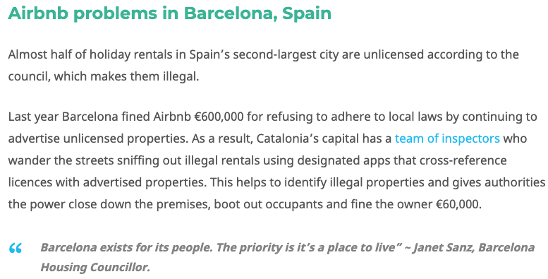
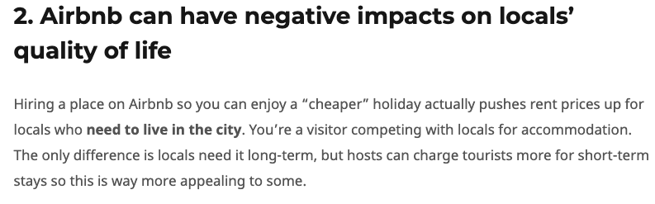
AirBnB problems
https://www.theinvisibletourist.com/why-you-shouldnt-use-airbnb-issues-you-didnt-know/

Slide 6


Slide 7
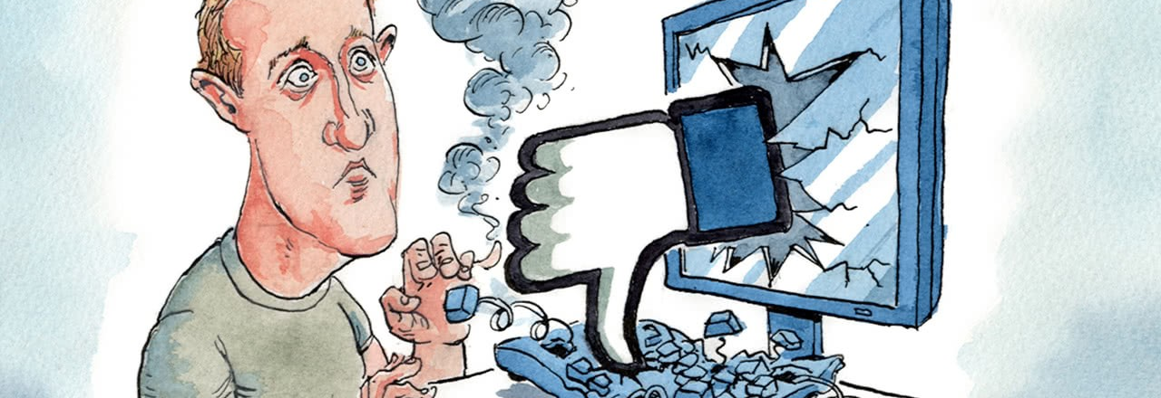
Facebook and political influence
Notes:
Automated accounts are used to alter political debate online
Lies and extremist groups are spread through the platform and gains followers
Personal data is mined and used for targeted messages

Slide 8
Goal | Implementation | Unintented effects
Helping people find private, cheap accomodation during vacations | AirBnB | Depopulated city centres, black market for hotels
Democratize currency | Bitcoin | Boon for criminal transactions, stimulating fraud, enormous energy consumption
Improve social networks in a world where people move away from each other | Facebook | Loss of trust, skewed worldview as Facebook harvets information and uses it to alter our perception of reality

Slide 9
These effects are the direct consequences of design choices in development
Why do developers make these choices?
Who is affected?
Does it matter?

Slide 10
What goals could or should you have when changing something?

Slide 11


Slide 12
Definition of Sustainability
Sustainability is the capacity to endure
For humans, as opposed to ecology, sustainability is the potential for long-term maintenance of well-being, which has environmental, economic, and social dimensions.
To analyse sustainability for a specific context or system it is necessary to define:
What to sustain? For whom? For how long? At what cost? [Joseph Tainter 2006]

Slide 13
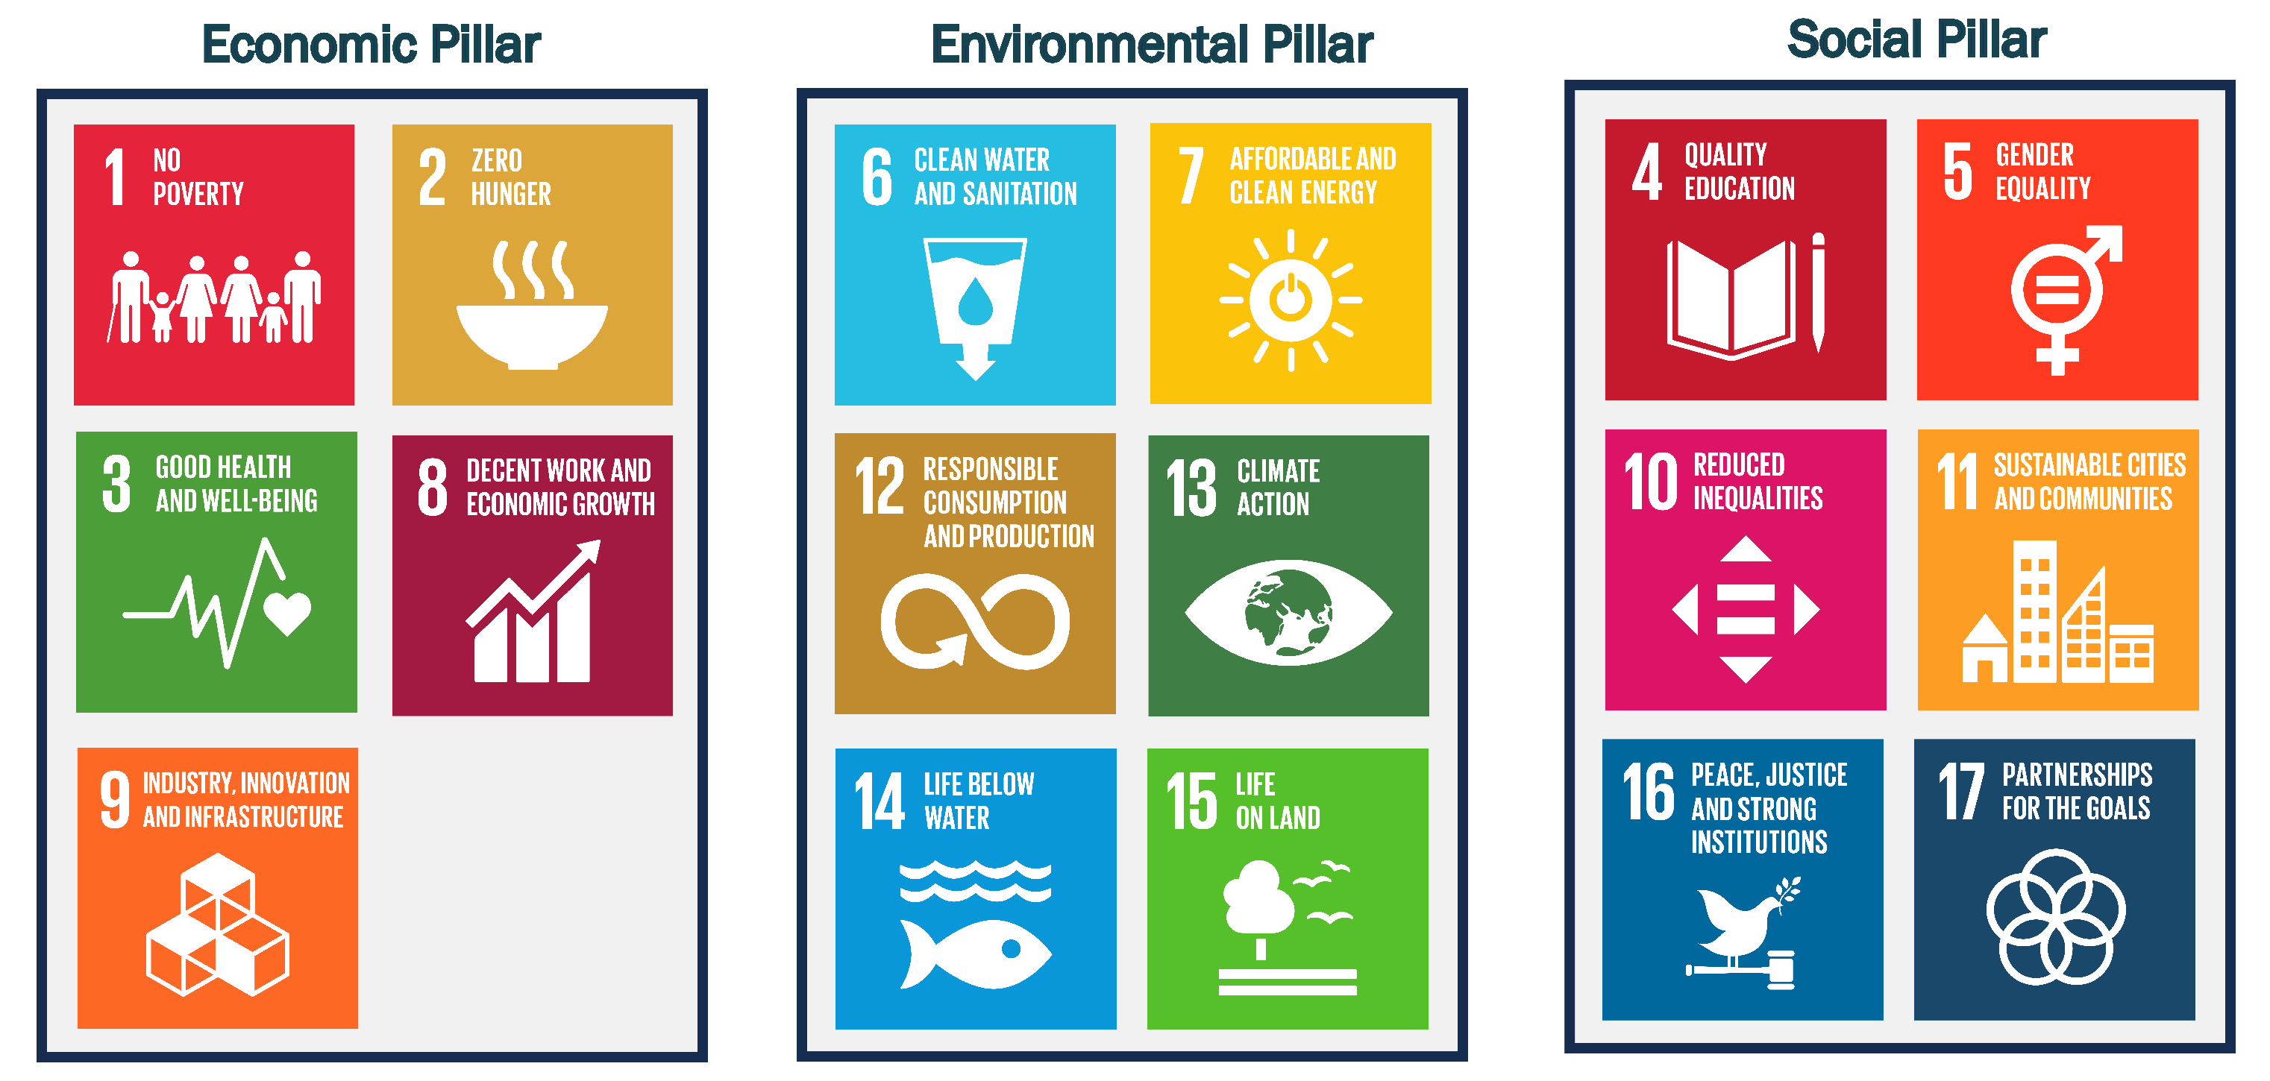
Three pillars of sustainability

Slide 14
Software Systems & Sustainability
Social-Environmental
Environmental justice
Natural resources stewardship
Locally & globally
Environmental-Economic
Energy efficient
Subsidies / incentives for use of natural resources
Environmental
Natural resource use
Environmental management
Pollution prevention
(air, water, land, waste)
Software systems support all aspects of our daily lives
As designers, we have a responsibility for long-term effects of our work products
How can we consider sustainability during software engineering?
Social
Standard of living
Education
Community
Equal opportunity
Sustainability
Economic
Profit
Cost Savings
Economic Growth
Research & Development
Economic-Social
Business ethics
Fair trade
Worker’s rights

Slide 15
Sustainability & Software Systems
Two main understandings for software systems
Green in IT: energy, hardware, efficiency e.g. green data centers
Green by IT: system purpose e.g. car sharing system
Again: How can we consider sustainability during software engineering?

Slide 16
Sustainability in software engineering
Business only focus vs advancing multiple dimensions simultaneously
Focus on internal stakeholders vs include external stakeholders
Focus on stakeholder want vs helping the stakeholder understand system’s enabling effects
Identify risks to timeley project completion vs include enabling and structural effects and risks that can develop over time

Slide 17
Designing Future Software for Sustainability: The Karlskrona Manifesto
What is going wrong?
Misperceptions
Framing sustainability as only protecting the environment
Dismissing sustainability as a distinct research discipline
Thinking that taking small steps in sustainability is sufficient, appropriate, and acceptable
www.sustainabilitydesign.org

Slide 18
Designing Future Software for Sustainability: The Karlskrona Manifesto
How to get it right?
Sustainability is systemic
… is multidimensional
… is interdisciplinary
… transcends the system’s purpose
… applies to both a system and its wider contexts
… requires action on multiple levels
… requires multiple timescales
Changing design to take long-term effects into account doesn’t automatically imply sacrifices
System viability is a precondition for and enabler of sustainability design

Slide 19
Designing Future Software for Sustainability: The Karlskrona Manifesto
As designers of software technology, we are responsible for the long-term consequences of our designs
www.sustainabilitydesign.org

Slide 20
Sustainability in Software Engineering
Starts with requirements engineering

Slide 21
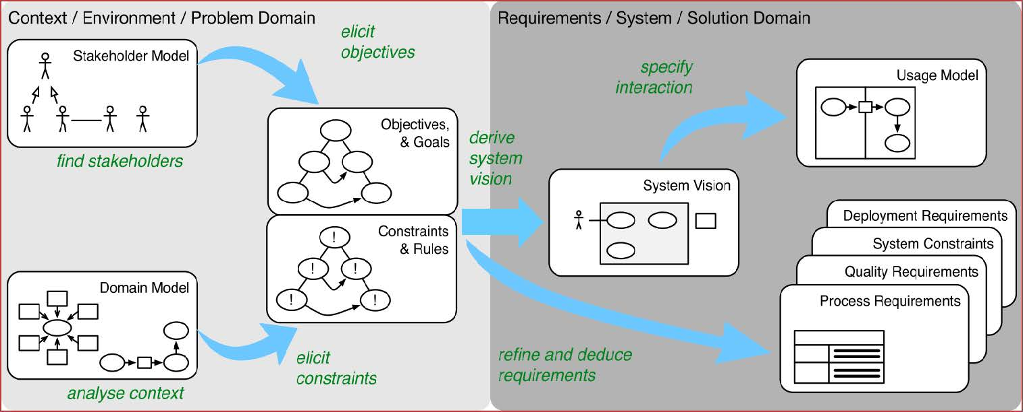
Requirements engineering

Slide 22
What is wrong with requirements engineering?

Slide 23
Questions for green requirements engineering
Does the system have an explicit sustainability purpose?
Which impact does the system have on the environment?
Is there a stakeholder for environmental sustainability?
What are the sustainability goals and constraints for the system?

Slide 25
A generic list of sustainability stakeholders

Slide 26
Notes:
Sustainability Reference Model (Excerpt)

Slide 28
Sustainability analysis
“What does X mean for my/our system?”
Sustainability dimensions
Environmental, individual, social, economic, technical
Orders of impact
Immediate
Enabling
Structural

Slide 29
Orders of effect
Immediate effects are the direct effects of the production, use, and disposal of software systems. This includes the immediate benefit of system features and the full life-cycle impacts, such as a life-cycle assessment (LCA) would include. A LCA evaluates the environmental impact of a product’s life from the extraction of raw material to its disposal or recycling.
Enabling effects arise from a system’s application over time. This includes not only opportunities to consume more (or fewer) resources but also other changes induced by the system use.
Structural effects represent “persistent changes observable at the macro level. Structures emerge from the entirety of actions at the micro level and, in turn, influence these actions.” Ongoing use of a new software system can lead to shifts in capital accumulation; drive changes in social norms, polices, and laws; and alter our relationship with the natural world

Slide 30
Rebound effect
In conservation and energy economics, the rebound effect (or take-back effect, RE) is the reduction in expected gains from new technologies that increase the efficiency of resource use, because of behavioural or other systemic responses. These responses usually tend to offset the beneficial effects of the new technology or other measures taken.
Example: People turn up the graphics settings when getting a newer and more efficient GPU; resulting in more power draw than the less efficient GPU.

Slide 31
Illustration of rebound effects

Slide 32
5 dimensions of sustainable design A software engineering perspective
Individual
maintaining human capital (e.g., health, education, skills, knowledge, leadership, and access to services)
Social
preserving the societal communities in their solidarity and services
Economic
maintaining capital and added value.
Environmental
improving human welfare by protecting the natural resources: water, land, air, minerals and ecosystem services.
Technical
longevity of information, systems, and infrastructure and their adequate evolution with changing surrounding conditions
Notes:
Penzenstadler, Birgit & Raturi, Ankita & Richardson, Debra & Tomlinson, Bill. (2014). Safety, Security, Now Sustainability: The Nonfunctional Requirement for the 21st Century. Software, IEEE. 31. 40-47. 10.1109/MS.2014.22.
https://www.sustainabilitydesign.org/karlskrona-manifesto/

Slide 33
The Sustainability Awareness Framework
Social
Individual
Environmental
Immediate effect
Technical
Enabling effect
Structural effect
Economical

Slide 34
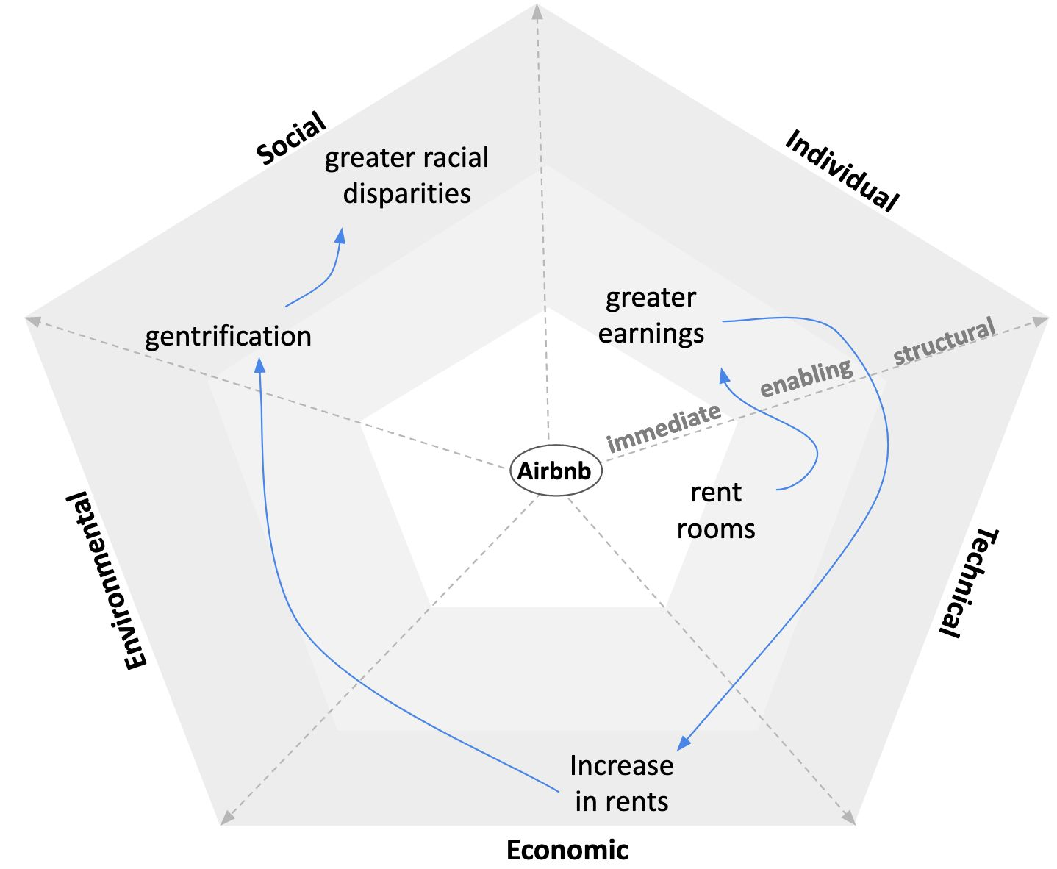
Notes:
Gentrification - the process whereby the character of a poor urban area is changed by wealthier people moving in, improving housing, and attracting new businesses, often displacing current inhabitants in the process

Slide 36
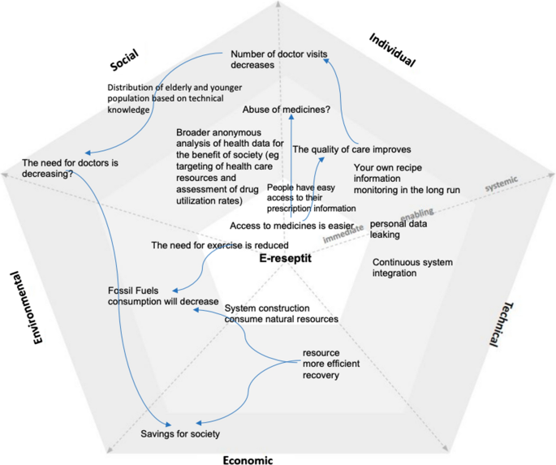
Notes:
Finnish service similar to 1177? The prescriber prescribes and signs all prescriptions electronically. You can get the prescription patient information sheet on paper, where you can see the names of the medicines and the dosing instructions. You can view your own recipe information in My Home.

Slide 37
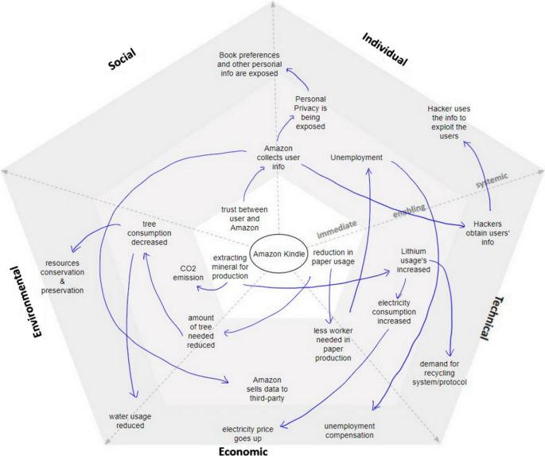

Slide 38
The SusA Framework workshop
Discuss the 5 dimensions of sustainable design in “Blocket.se” or ”Ebay.com”
Guided by several questions per dimension
Identify immediate, enabling and structural effects
Identify relations between effects
Create the SusA radar diagram
Present your radar diagram for another group

